Slide 1


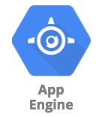
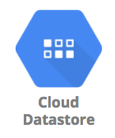


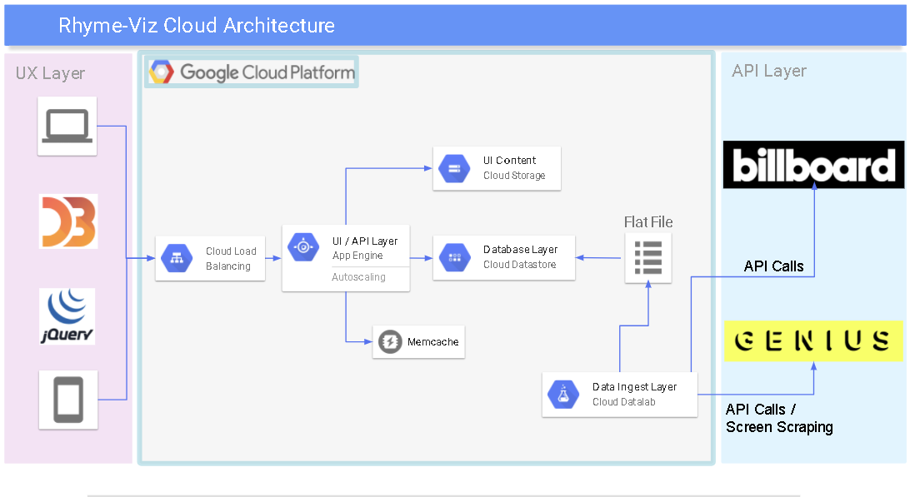
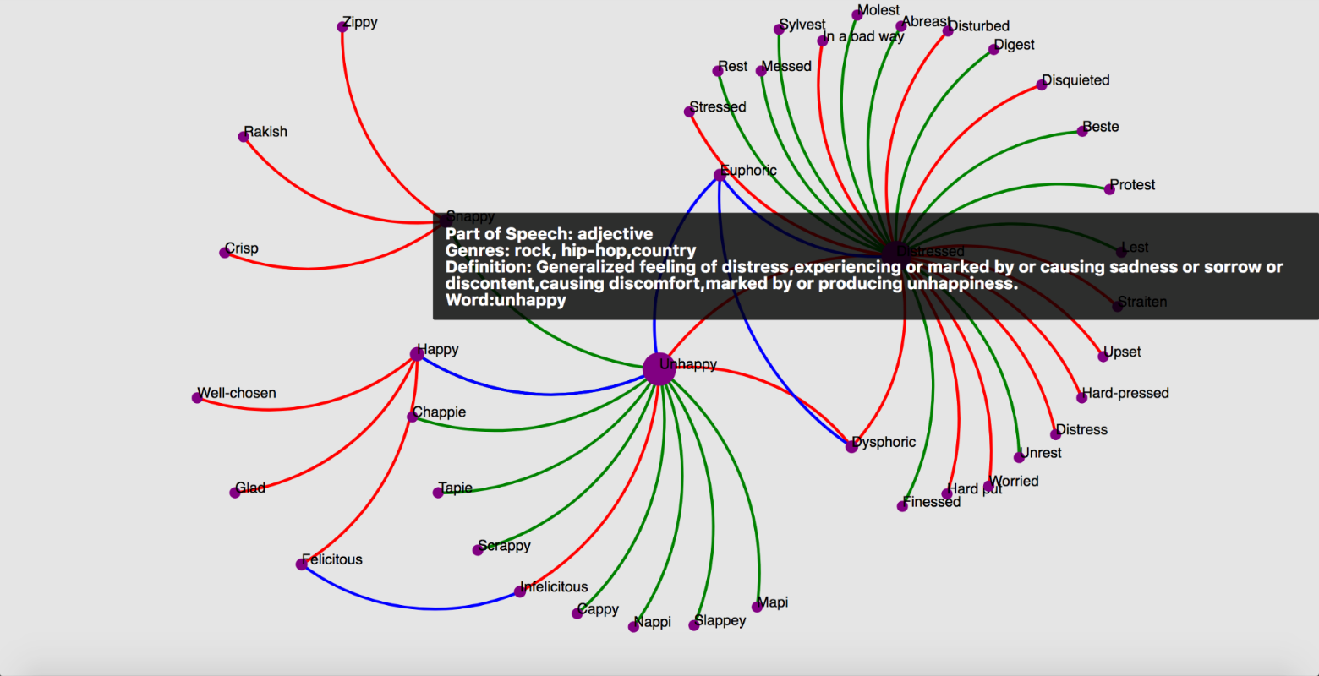
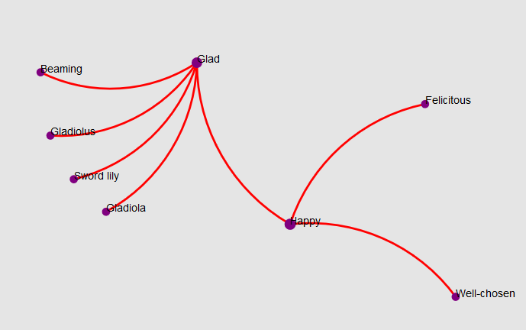
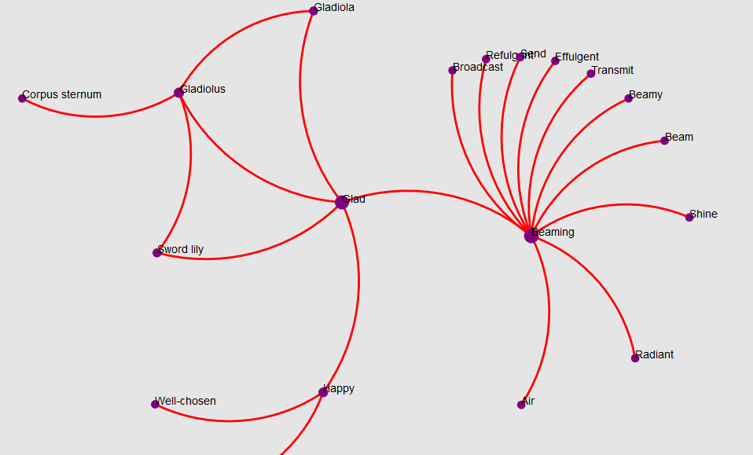
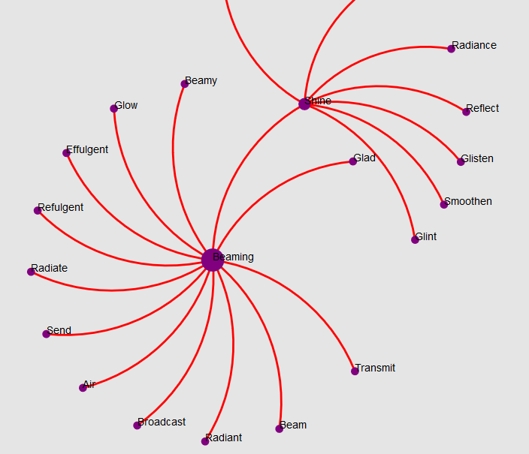
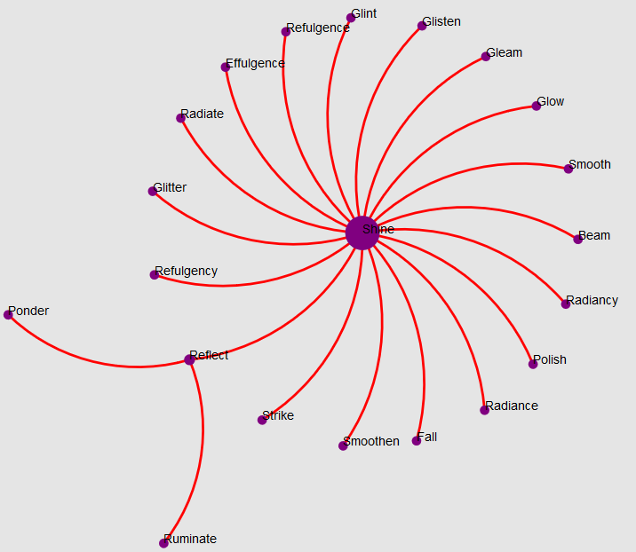

Interactive Assistant Tool for Exploration of Rhymes and Synonyms (Rhyme-Viz)
Majid Ahadi, Patrick Fleming, Jag Gangemi and Robert Martin
CSE6242- Data and Visual Analytics
Introduction
Rhyme-Viz Architecture
Problem statement
Finding rhyming words for a poem is a considerable challenge.
Going through a rhyming dictionary or a thesaurus can be exhausting.
Visualization makes this task much easier.
Solution
A comprehensive visual and interactive program to simplify exploration of rhymes and synonyms for poets in a continuous graph structure.
Rhyme-Viz utilizes a “serverless” architecture running on Google Cloud Platform. By leveraging cloud services our team was able to focus on developing our software and refining our data.
User Interface - D3 and Javascript running on Google App Engine
API Layer - Python serving REST / JSON via Google App Engine
Data Layer - NoSQL key-value store running on Google Cloud Datastore
Data Ingest Layer - Python notebooks running on Google Cloud DataLab
Word Analysis
Proposed Approach and Data
On mouse over RhymeViz provides more information on each word
Definition
Parts of speech
Genres
Genres data is generated by scrapping and API calls
billboard.com gives us top 300 songs of the past 20 years
genius.com gives us lyrics of each song
With some coding RhymeViz tells in which genres the word is common.
Data resources
Dictionary databases from the Python Natural Language Toolkit
150,000 words and about 60 megabytes
Additional scraped data from billboard.com and Genius.com for word analysis
Cloud Architecture
Application submits get requests through jQuery
API returns JSON formatted data
Visualization
D3 force layout is used to create an interactive graph
Shows Synonyms and/or antonyms and/or rhymes
Explorer mode lets user to hop from one word to another and load more results
Experiments and Results
RhymeViz is evaluated through a user Study
Experiment details
Baseline
Online thesaurus: thesaurus.com
Online rhyming dictionary: rhymezone.com
User were asked to the following first with RhymeZone and then with the websites
Imagine they are writing a song
Choose an initial word
Find a synonym for the initial word
Find a rhyme for the synonym
Explore and play with different options
Repot timing, pros and cons and general feedback
Results
Timing: RhymeViz and wesites require about the same time
Pros and cons of RhymeViz
In general users supported the idea and implementation and described it as a fun experience!
Explorer Mode
This mode helps with
Moving to neighboring nodes
Discovering new synonyms, antonyms and rhymes
Happy
Glad
Pros | Cons
Cool design and idea | Sometimes shows too many words
Shows interaction of words | Occasional software crash and bugs
Explorer mode | Limited synonyms
Genres analysis | Looks can improve
Beaming
Shine
Contact
Majid Ahadi - majidahadi@gatech.edu, Patrick Fleming – pjfleming@gatech.edu
Jag Gangemi - jg5813@gatech.edu, Robert Martin - robartin@gmail.com

